Slide 1
REIA Multifamily Market Update
10/16/24
Ron DeVries, MAI
rdevries@irr.com
Integra Realty Resources
1 N Franklin, Suite 3340
Chicago, IL 60606

Slide 2
The Suburban Dataset – 2Q24

Slide 3
The Suburban Dataset – 2Q24
YOY net rent growth
3.2%
Slower growth after HH growth boom but remains positive

Slide 4
The Suburban Dataset – 2Q24
Modest supply growth continues

Slide 5
Class A & B Rent Trends Downtown – 2Q24
Year over Year Change
Class A -0.27%
Class B 0.31%
10 buildings
$4.50+ psf NET

Slide 6
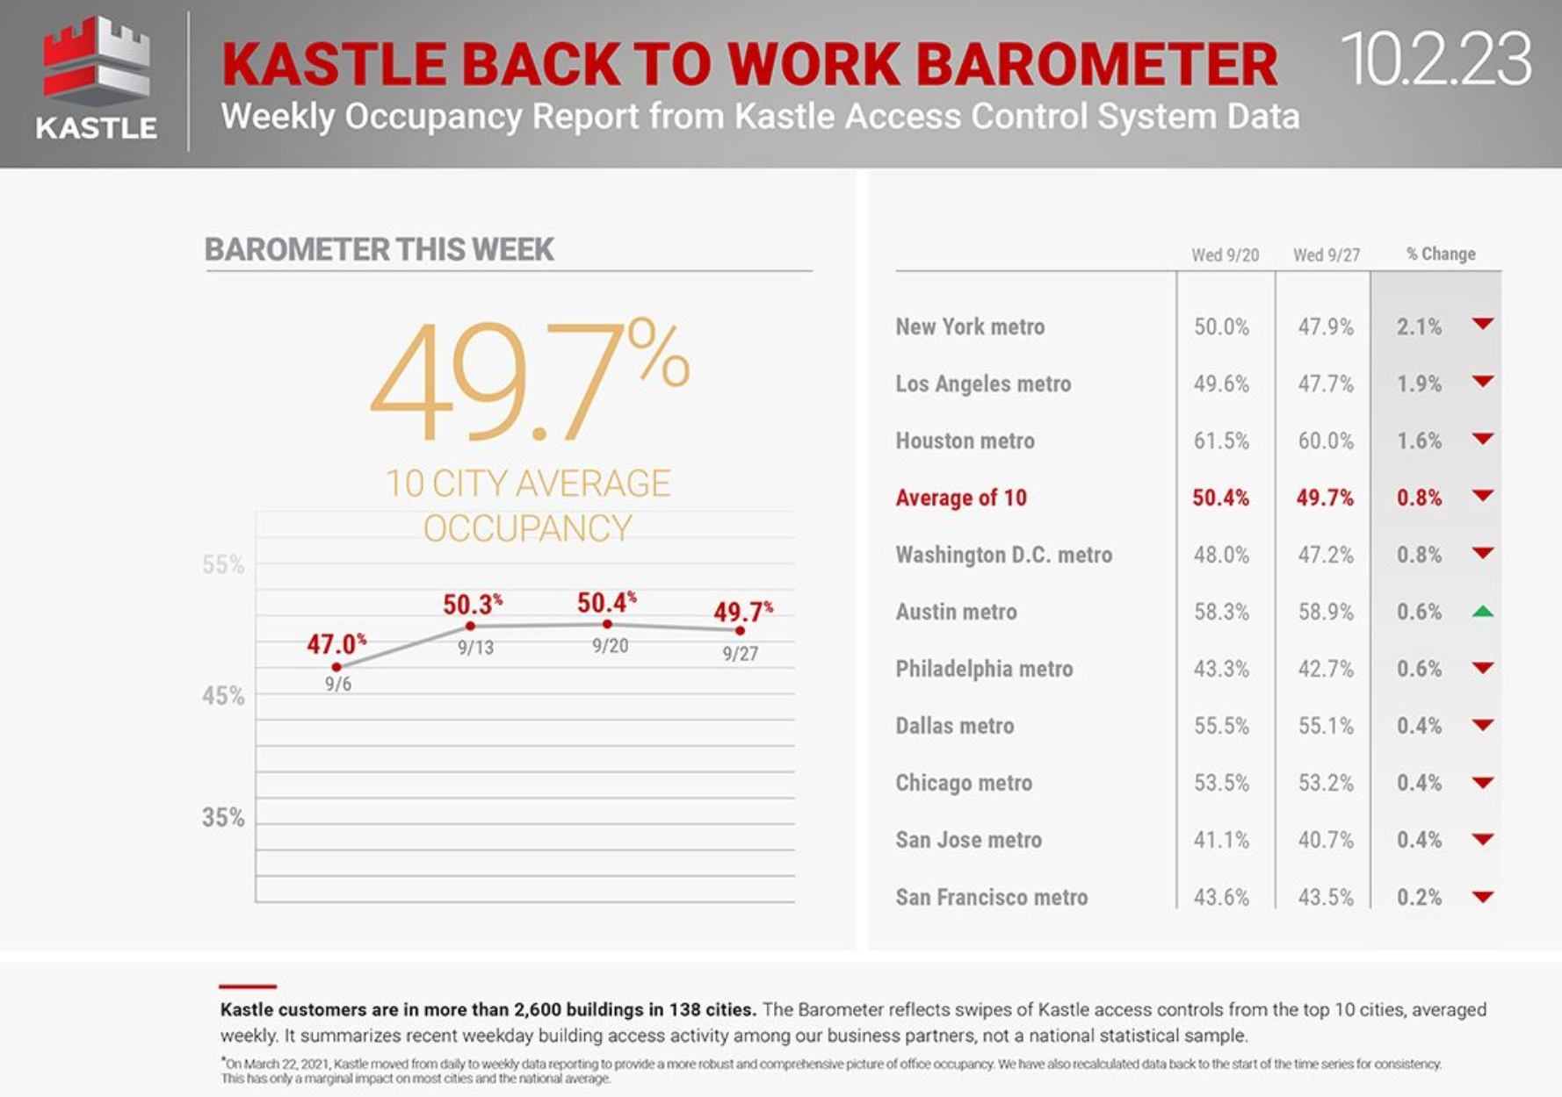
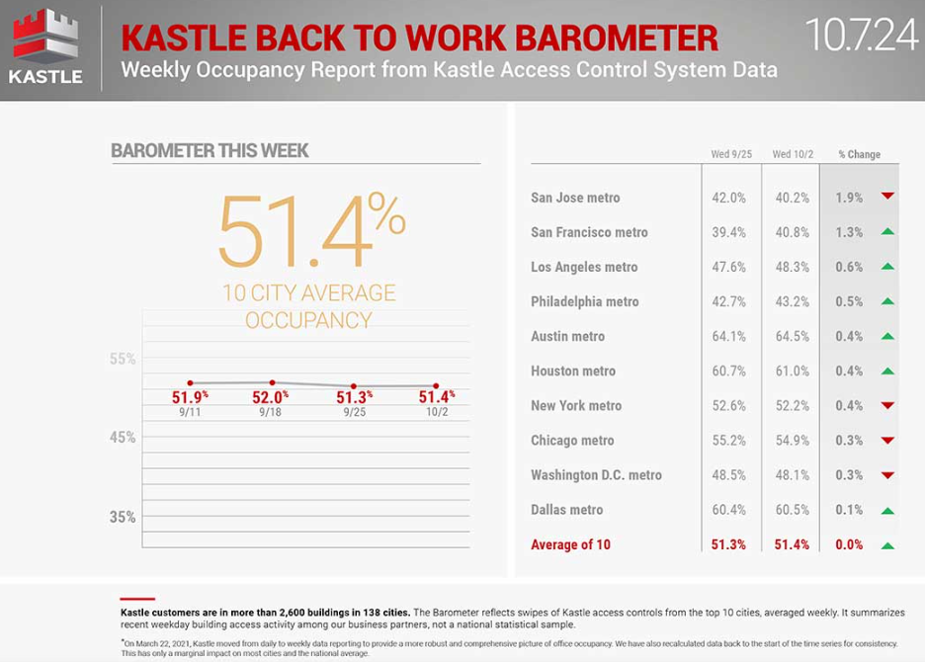
Return to Office – What a difference a year makes
Or does it?
Chicago – 53.2% (2023) vs 54.9% (2024)

Slide 7
Absorption Vs Supply Downtown
New construction virtually shut down
Debt & Equity markets
RE Tax uncertainty
Rent spikes 2025 / 2026?

