Slide 1
What are Opportunity Zones?
An Opportunity Zone (OZ) is a population census tract that meets the definition of a “low-income” community as that term is defined in the Internal Revenue Code in the context of the New Markets Tax Credit
These census tracts have been specifically designated as a Qualified Opportunity Zone (QOZ) under section 1400Z-1
IRS Notice 2018-48 includes an official list of all population census tracts designated as QOZs
There are now over 8,700 certified QOZs in all 50 states, DC, Puerto Rico and the Virgin Islands
Notes:
What is the Program’s purpose?
Congress refers to it as an “economic development tool”
It is intended to incentivize the movement of capital into these designated areas to develop property and create and expand businesses in an effort to reduce poverty and increase employment
“Economic revitalization”
The New Markets Tax Credit Program was established as part of the Community Renewal Tax Relief Act of 2000.
provides tax credit incentives to investors for equity investments in certified Community Development Entities, which invest in low-income communities
the credit equals 39% of the investment paid out (5% in each of the first three years, then 6% in the final four years, for a total of 39%) over seven years (more accurately, six years and one day of the seventh year).
ADDITIONAL OPPORTUNITY ZONES???

Slide 2
What are the tax incentives for investment in a QOZ?
Defer Capital Gain
Partial Forgiveness of Capital Gain
Total Forgiveness of Appreciation

Slide 3
How does it work?
Taxpayer realizes a gain from a actual or deemed sale or exchange with an unrelated person of any capital gain property held by the taxpayer, and
Invests all or a portion of that realized gain into a “qualified opportunity fund” (QOF) within 180 days of that realization event, then
The taxpayer can elect to defer the invested gain until the earlier of
(a) the date the taxpayer sells or exchanges its investment in the QOF, or
(b) December 31, 2026—phantom gain event
If interest is held for 5 years, 90% of the deferred gain is subject to tax
If interest is held for 7 years, 85% of the deferred gain is subject to tax
Notes:
MAKING THE ELECTION: ON FORM 8949, WHICH WILL BE ATTACHED TO THE TAX RETURN FOR THE TAXABLE YEAR IN WHICH THE GAIN WOULD HAVE BEEN RECOGNIZED IF IT HAD NOT BEEN DEFERRED. FORM 8949 INSTRUCTIONS ON THIS FORTHCOMING
180 day rule: first day of 180 day period is the date on which the gain would be recognized for federal income tax purposes
Phantom gain event 2026.
All of the deferred gain’s tax attributes are preserved through the deferral period and are taken into account when the gain is included
If a taxpayer disposes of less than all its fungible interests in a QOF, the proposed regs say that the QOF interests disposed must be identified using FIFO
Tax code requires investors to sell equity in QOF investment to claim benefit of 10 year rule. Significant structuring hurdles for anyone wanting to form a multi-asset commingled fund, since sale of a single asset would be a taxable event to the QOF investors, and an entity sale of a multi-asset QOF would require a buyer to purchase the entire portfolio

Slide 4
Qualified Opportunity Fund
Statutory requirements for QOF
Must be a corporation or partnership—LLC qualifies
QOF organized in the U.S. for the purpose of investing in QOZ property
90% of assets must be QOZ property on two measuring dates—6 months and end of calendar year
QOZ Property = (1) QOZ Stock; (2) QOZ Partnership Interest; (3) QOZ Business Property
Certification process
QOF self-certification on Form 8996 → No formal IRS approval
Noncompliance monthly penalty for failure to meet 90% test
Federal short-term rate plus 3%
Notes:
Form 8996 → Entity can choose which month in its initial taxable year that entity wants to start being a QOF, which does not have to be the first month in which the entity was created; so, entity can be created and can begin certain tasks (getting permits, making zoning applications, etc.)
Pre-existing entity may qualify as QOF or as issuer of qualified opportunity zone stock or of a qualified opportunity zone partnership, provided the pre-existing entity satisfies the general requirements
Valuing assets (for 90% test): proposed regs require the QOF to use asset values that are reported on the QOF’s applicable financial statement for the taxable year (if no FS, then use cost of its assets)
Regs clarified that equity interest not impaired by taxpayer’s use of the interest as collateral for a loan
Form 8996 to be used for self-certification AND annual reporting of compliance with the 90 percent asset test in section 1400Z-2(d)(1). 8996 to be attached to the taxpayer’s Federal income tax return for the relevant tax years.

Slide 5
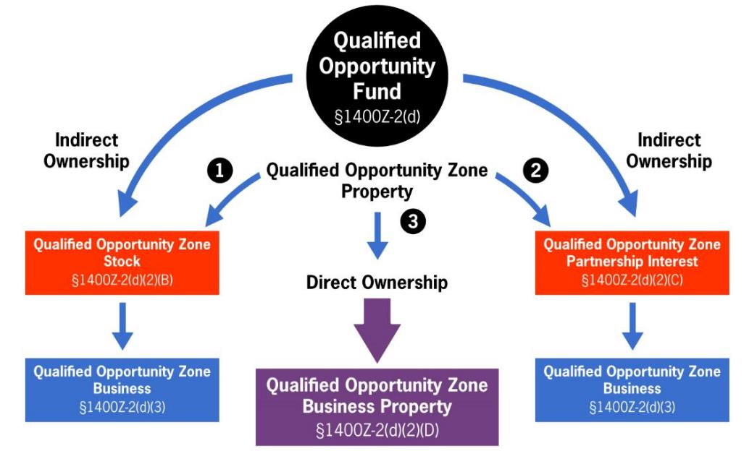
Options for direct or indirect QOF investment
Notes:
Initially it was thought that it would be better to structure with the direct ownership structure as there were less requirements to meet. However, the regulations that were released promote the use of subsidiary corporations and partnerships, or the so-called “indirect structure”
Regarding indirect--these QOF subs are NOT QOFs themselves; the sub is essentially a JV entity. A QOF cannot own another QOF.

Slide 6
Qualified Opportunity Zone Business Property
The term “qualified opportunity zone business property” means tangible property used in a trade or business of the QOF if:
The property was acquired by the QOF by purchase from an unrelated party (20%) after December 31, 2017, and
The original use of such property in the QOZ commences with the QOF or the QOF substantially improves the property, and
During substantially all of the QOF’s holding period for such property, substantially all of the use of such property was in a QOZ
What “substantially all” means in this context has not yet been defined; additional proposed regs forthcoming
Notes:
The regulations leave for another day the “definition” of original use. Two things we did learn about original use from the recently released guidance was that (1) given the permanent nature of land, its acquisition can never meet the “original” use test, and (2) the acquisition of a building located in a QOZ, the acquisition by the purchaser is also not considered to meet the “original use” test

Slide 7
Original use or substantial improvement
The original use of the property in the QOZ commences with the QOF or there must be “substantial improvement” to the property
With “substantial improvement”, the QOF has a 30-month window to improve the property, such that the basis of the property increases by an amount that exceeds the amount of the adjusted basis of the property at the beginning of the 30-month period (basis must double)
Rev. Rul. 2018-29: if a QOF acquires a building and land for $10M (building $6M and land $4M) at end of 30-month period improvements of $6M +$1 must be made.
There is no requirement to improve the land—a boost for urban areas with expensive land
Notes:
“Original use” → Questions regarding appropriate metrics for tangible property; comments sought. What if the property was a vehicle or other movable property that was previously used within the OZ but acquired from a person outside the OZ? Should some period of abandonment or under-utilization of tangible property erase the property’s history of prior use in an OZ?
Original use suited for ground up development
The Code describes the time-period for substantial improvement as “any 30-month period”…The regulations do not (1) provide for any breaks or pauses in the 30-month period or (2) do not address what triggers the beginning of the 30-month period
Substantial improvement suited for property in an OZ with land and an existing building

Slide 8
Qualified Opportunity Zone Business—Indirect investment
This is the two-tiered structure with the QOF having equity (stock or partnership interest) in a lower tier QOZ business (not itself a QOF)
The term “qualified opportunity zone business” means a trade or business:
(1) In which substantially all of the property owned or leased is QOZ business property
Regulations defined “substantially all” to mean 70% of the property owned or leased is QOZBP, permits the ability to have a “bad asset”
(2) At least 50% of the gross income from the business “is derived from” the active conduct of a trade or business
(3) If there is intangible property, that a substantial portion of it is used in the trade or business
(4) There is no more than 5% non-qualified financial property + reasonable amount of working capital
Regulations provide a 31-month safe harbor for working capital held by the business if certain requirements are met. Significantly reduce risk for QOF for failing to met 90% test
(5) The QOZ business is not engaged in a “sin” business as described in Section 144(c)(6)(B)
Notes:
To the extent that a QOZ business owns or leases tangible property, at least 70% of such property must be QOZ business property. Consequently, have to meet the requirements we spoke of earlier with the direct method plus these requirements. 70% GIVES QOZs AN INCENTIVE FOR INDIRECT INVESTMENT RATHER THAN OWNING QUALIFIED OPPORTUNITY ZONE BUSINESS DIRECTLY
Suppose QOF has 10M. If directly invests in real estate, must be at least $9 million
If QOF invests in a subsidiary that holds real property, then the sub only needs to invest $7 million of the 10M; or, only 6.3 million of 9 million (to meet bare minimum 70% and 90% tests).
The next three requirements come from the NMTC program and the OZ Code section references 1397C(b)(2), (3), and (4)
“at least 50 percent of the total gross income of such entity is derived from the active conduct of such business”—it does not say that the 50% derived from the QOZ business has to be generated in the confines of the QOZ, think of remote sales businesses
“a substantial portion of the intangible property of such entity is used in the active conduct of any such business”
“Reasonable amount of working capital”—the regulations provided that cash held as working capital by a QOZ business will apply toward meeting the 90% test if expended during a 31-month safe harbor as long as the cash is used to acquire, construct or substantially improve the QOZ property. There must be a written plan in place to deploy the capital and the capital is used consistently with the plan.
Unclear at this time whether project for which working capital is used must be completed within 31 month period
Section 144(c)(6)(B)-Golf course, liquor store,

